Slide 1
FTTH Planning and Recommendation
Chetan Gulecha - MT2020052
Md Aqueeb Jawed - MT2020110
Pratik Pawar - MT2020121

Slide 2
Background
Link to Design and Implementation FTTH network paper
This paper presents GPON FTTH access network architecture. The basic components of networks are presented and contribution of each component to FTTH network is addressed.
Link to Simple GIS based method for designing fiber-network
The urban maps can be preprocessed before planning such that the established plan should be aimed to cover the region with lowest cost but with high degree of construction flexibility.

Slide 3
Problem Definition
Objective
Tedious work for large networks
Scalability, Flexibility in construction
Customization
Could take days to design it manually
The objective of this project is to recommend a FTTH network for selected area which could solve all the problems and companies could seamlessly manage the entire integrated infrastructure.

Slide 4
Components / Terminologies of FTTH
FTTH (Fiber to the home)
FTTH (fiber-to-the-home) is a form of fiber-optic communication delivery that reaches one living or working space.
Other options: Cable internet, DSL (Digital subscriber line)
FTTH is faster as fibre cable reaching at home
OLT (Optical Line Terminal )
The engine that drives FTTH system, as this connects created network to the internet
OLT perform traffic scheduling, buffer control and bandwidth allocation

Slide 5
ONT (Optical Network Terminal)
ONTs are deployed at customer’s premises.
ONTs are connected to the OLT by means of optical fiber
Optical splitters
Enables sharing of each fiber by many users
Each link (fiber) entering the splitter may be split into a given number of fibers leaving the splitter
Eg.Two 1:16 splitters can be connected by one 1:4 mid splitter
GPON (Gigabits Passive Optical Network)
Shared optical fiber to the premises network architecture
Unpowered optical splitters

Slide 6
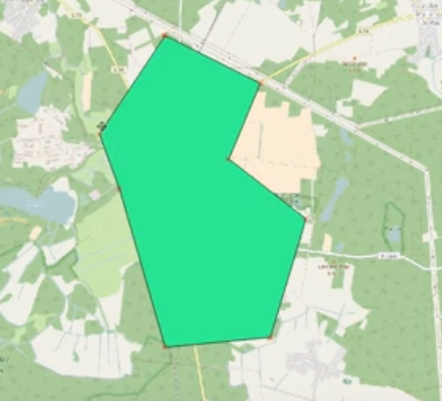
Workflow
-Layered approach
Each layer will perform its task and pass information to next one.
Base Layer: OpenStreetMap(OSM)
-For planning and recommendation we need to consider several factors like:
Area to be planned, buildings, their area ,roads etc.
Area to be selected
Vector data

Slide 7
2) Demand points
Helps analyzing importance of cluster
ONT serves as the endpoints
Can’t treat each building same. Here we have assumed that larger the building larger bandwidth/data connectivity is needed
According to area demand points are assigned
For eg.
Building with area <= 400 sq.ft (Points assigned 1)
Building with 401 <=area <= 1000 sq.ft (Points assigned 2)
Building with area >= 1001 sq.ft (Points assigned 4)

Slide 8
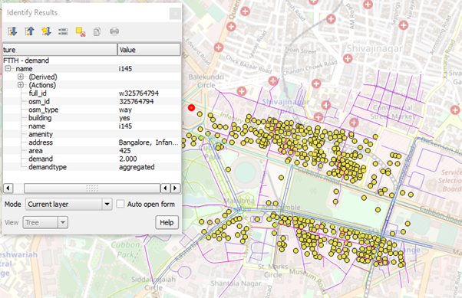

Slide 9
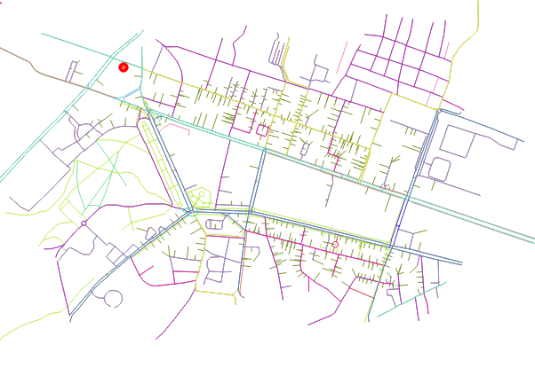
3) Roads and potential route line

Slide 10
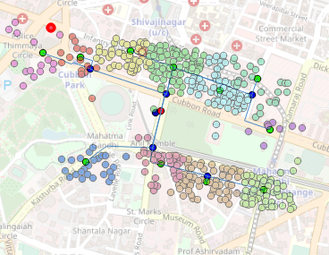
4) Clustered demand
K-means cluster is used to create clusters.
Max. cluster that can be formed can be configured.

Slide 11
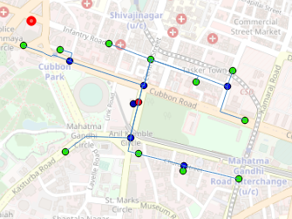
Result
Recommended network
5) Network plan
BRANCH (blue)
FINAL(green)
OLT(red)

Slide 12
Analysis
Data produced by layers exported to Excel sheets
FTTH → Fibre line (length, connections), potential points (demand)
Serving area → Point and cluster related info (cluster id , demand, location)
Splitters → Info. about splitters and at potential nodes
Future Work
-Analysis based on cost
Which nodes, lines are beneficial compared to others

